Slide 1
ECE499/ECE590 Machine Learning for Embedded Systems (Fall 2021)
Lecture 1: Course Information and Introduction to Machine Learning
Weiwen Jiang, Ph.D.
Electrical and Computer Engineering
George Mason University
wjiang8@gmu.edu

Slide 2
Agenda
Course Information
Logistics
Motivation
Overview
Introduction to Artificial Neuron and MLP

Slide 3
Course Logistics

Slide 4
Course Resources
Course Website:
https://jqub.github.io/2021/09/01/ML4Emb/
Slides, readings, and documents will be posted here!
Assignments will be posted here! (Until Blackboard can be used)
Blackboard:
Assignments will be posted and submitted here!
Piazza:
Online discussion, shared documents, announcements.
Do NOT upload codes.

Slide 5

About Me.
Background
Researcher at University of Pittsburgh (2017-2019)
Postdoc at University of Notre Dame (2019-2021)
George Mason University (2021 - present)
Research Interests
HW/SW Co-Design
Quantum Machine Learning
Contacts:
wjiang8@gmu.edu
(412)427-0695
https://jqub.github.io/
Dr. Weiwen Jiang

Slide 6

Teaching Assistant
XXX
XXX@gmu.edu
Office Hours: TBD

Slide 7
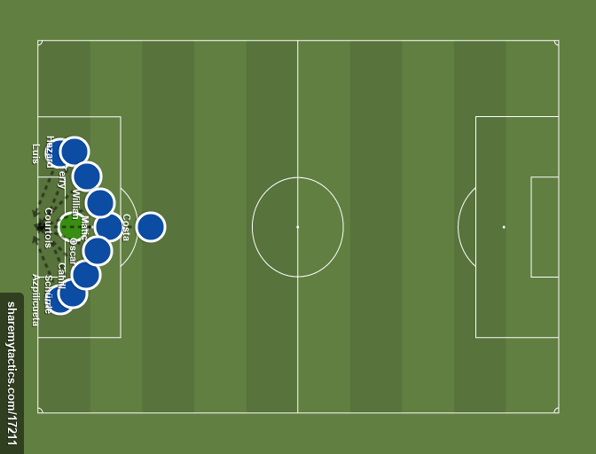
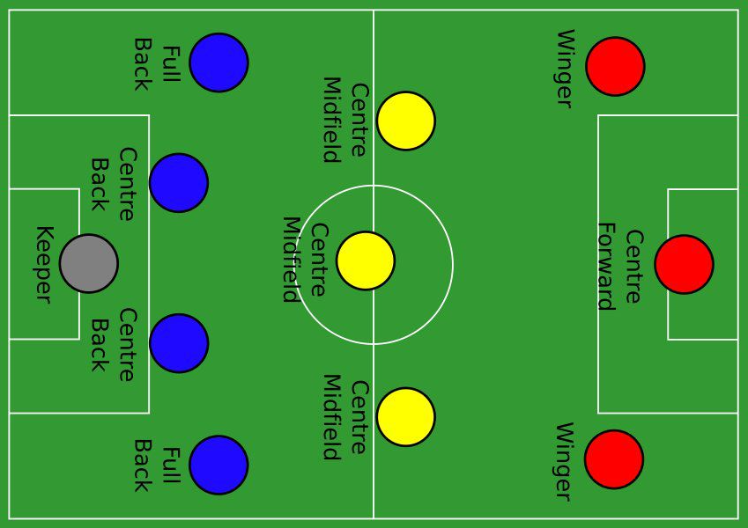
Lecture-Presentation-Lab Hours
Good Stuff
No quizzes
No mid-terms
No finals
Contents driven by demand and interest
10-0-0
(No!)
“Bad” Stuff
You’ll have to make presentation or critiques
You’ll have to hand-on labs
You’ll have to work on a final project
Eventually, they will do you good!
4-3-3
(Yes!)

Slide 8
Grading Policy
Undergraduate (ECE 499)
Homework & Labs 50%
Paper Critiques 10%
Project progress review 10%
Project final review 30%
Graduate (ECE 590)
Homework & Labs 50%
Research paper presentation 20%
Project progress review 10%
Project final review/report 20%

Slide 9

You have been warned. Zero tolerance!
Lecture content and materials should NOT go online without explicit permission
No plagiarism!
The most common sense of way interpreting no plagiarism: You need to DO your work.

Slide 10


ML Programming Platform
https://colab.research.google.com/

Slide 11
Course Motivation

Slide 12


Slide 13


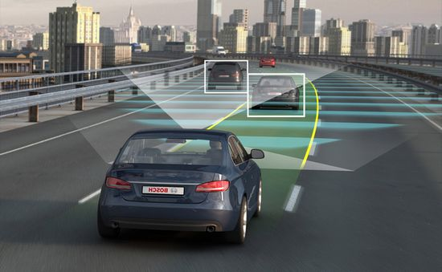

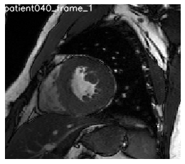
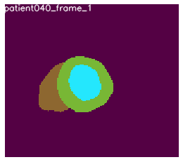
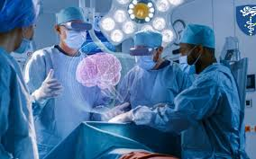
ML Applications
Game Play
Autonomous Driving
Medical AI

Slide 14
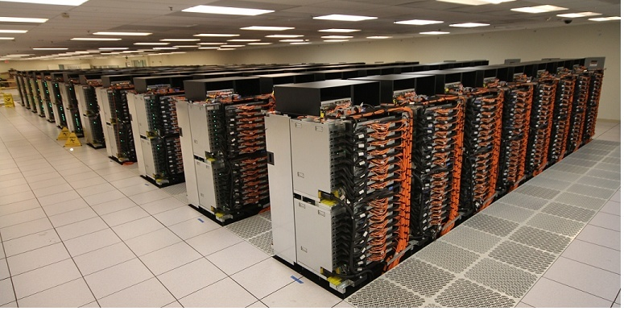
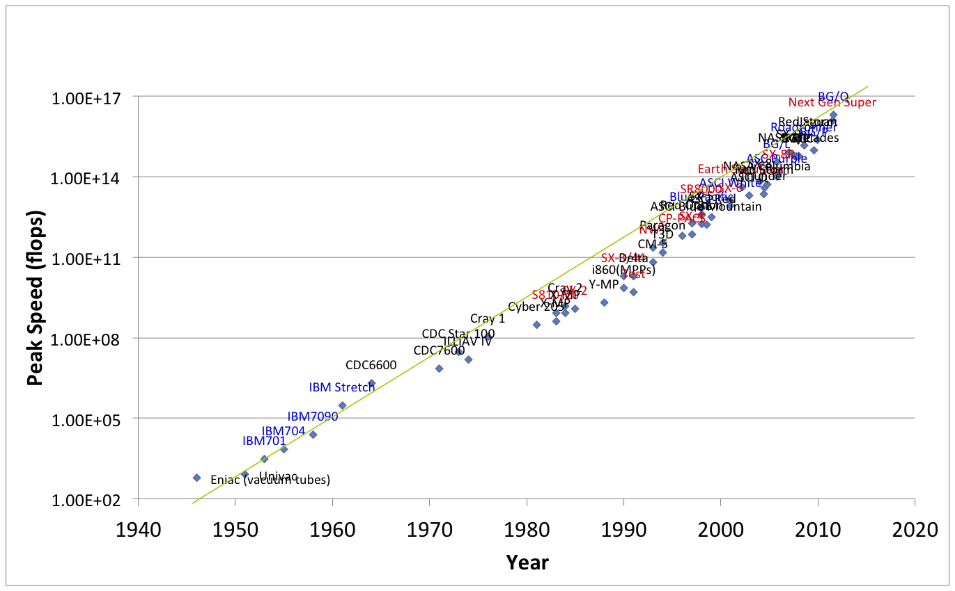
Race of Computer Powers Enables ML
Credit: IBM Blue Gene/Q Supercomputer

Slide 15
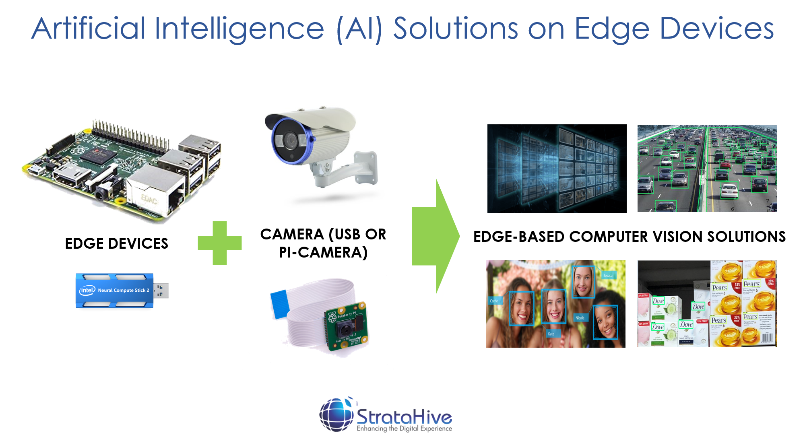
Machine Learning on the Edge

Slide 16
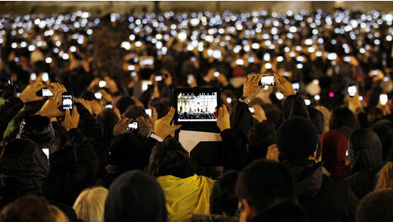
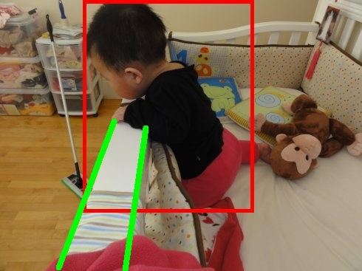
Why on the Edge?
Latency Problem
Privacy Leakage
Cost/energy efficiency considerations
Delay & Latency
Speed
WiFi Access
Data uploaded to the server
Privacy concerns

Slide 17
Why on the Edge?
14.6
billions
Smart end devices
Apple, Qualcomm, Spreadtrum, HiSilicon, Mediatek, annual volume
AI chip bearing artificial intelligence algorithm，billion dollar market opportunity
Big data，Maturing algorithm，
Core processor for AI Chip is the key
Global AI market exceeds US$100 billions
AI chip market will exceed US$10 billions
Data
Massie data and frequent human computer interaction
Calculation
Engineering methods and simulation methods require the use of convolutions.
Hardware
Insufficient calculation, AI chips provide computing power: GPU, FPGA, ASIC, TPU
9
billions
Home appliance
Smart appliance, digital TV, set top box, game console, VR/AR annual volume
200+
billions
Global AI Chip Market is Expanding!
Autopilot
ADAS chip market potential
Source: CCID，NVIDIA，Intel，gartner，CITIC Securities

Slide 18
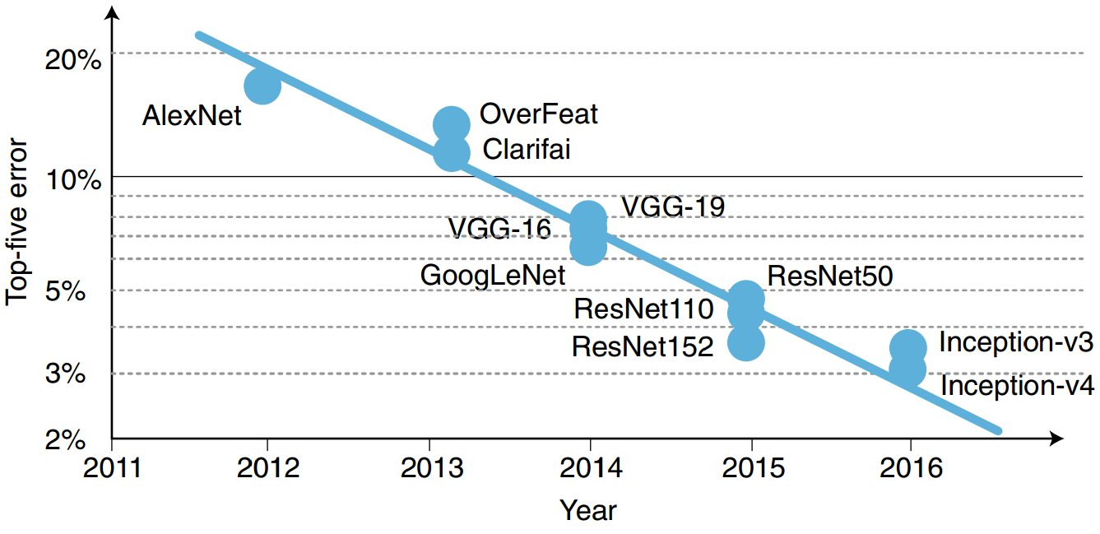
Challenges of ML on Edge Error rate improved exponentially
Error rate decreases by approximately 30% each year
Xu, Xiaowei, et al. "Scaling for edge inference of deep neural networks." Nature Electronics 1.4 (2018): 216.

Slide 19
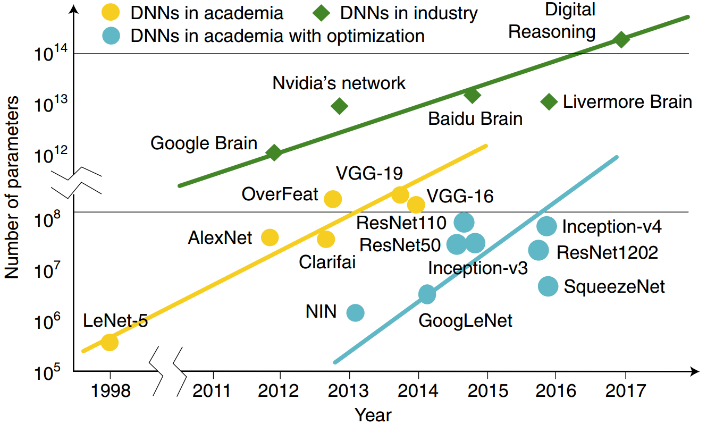
Challenges of ML on Edge Size of machine learning model also increases exponentially
Xu, Xiaowei, et al. "Scaling for edge inference of deep neural networks." Nature Electronics 1.4 (2018): 216.

Slide 20
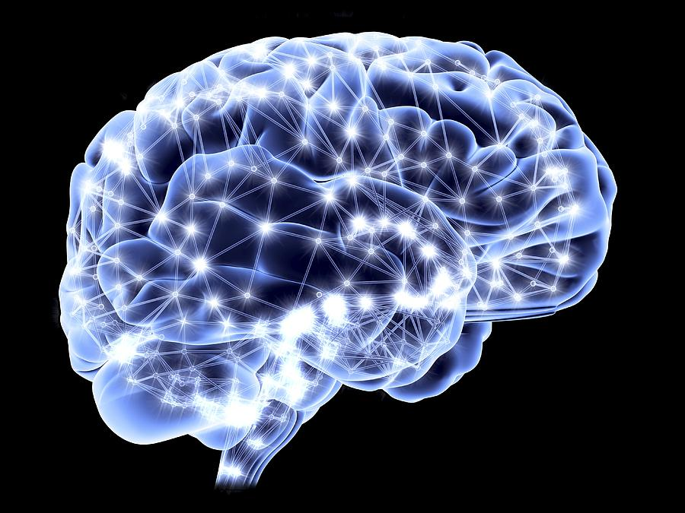
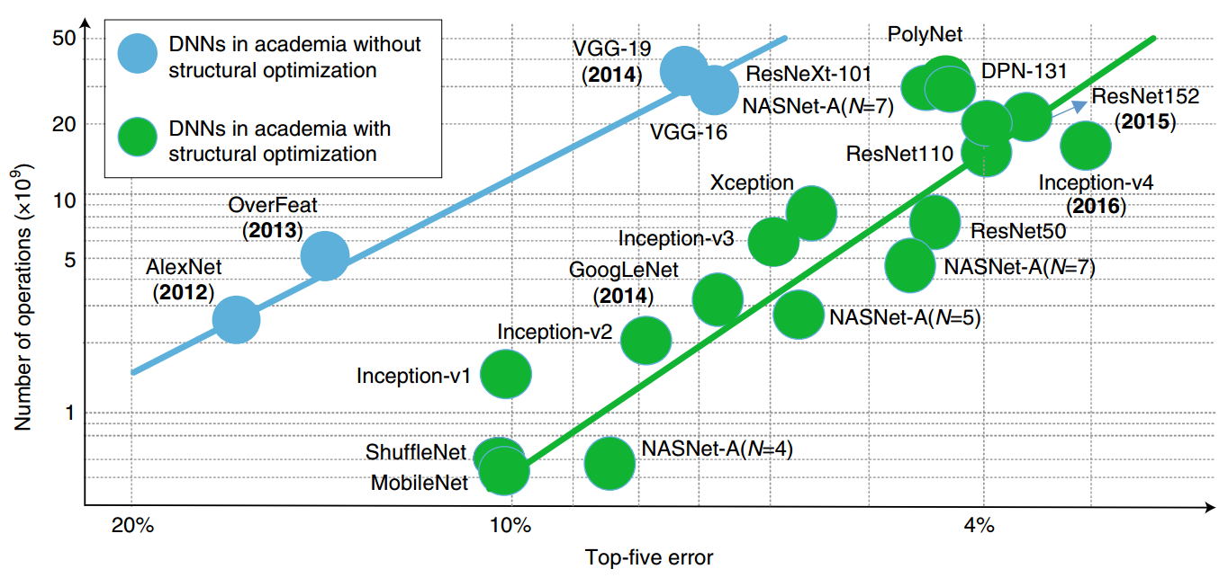
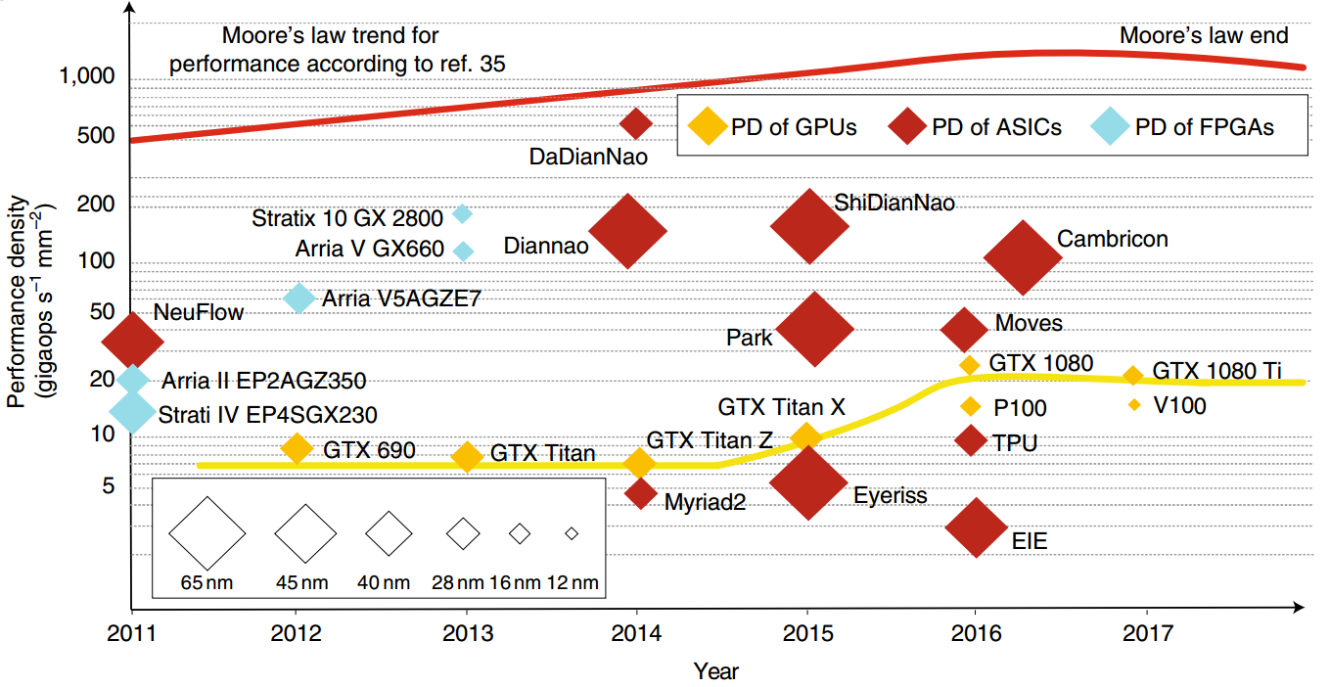
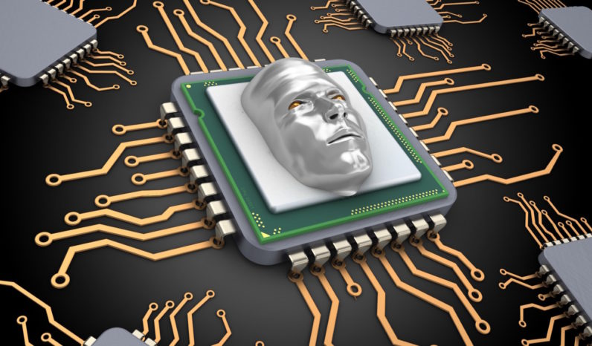
Challenges of ML on Edge Computing performance gap
Number of DNN operations
increases exponentially
Performance density almost stops increasing
Xu, Xiaowei, et al. "Scaling for edge inference of deep neural networks." Nature Electronics 1.4 (2018): 216.

Slide 21
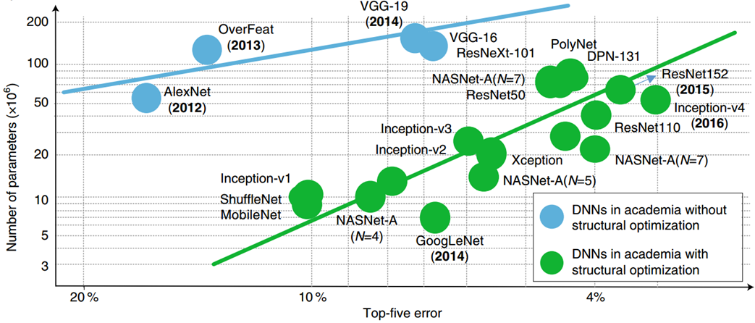
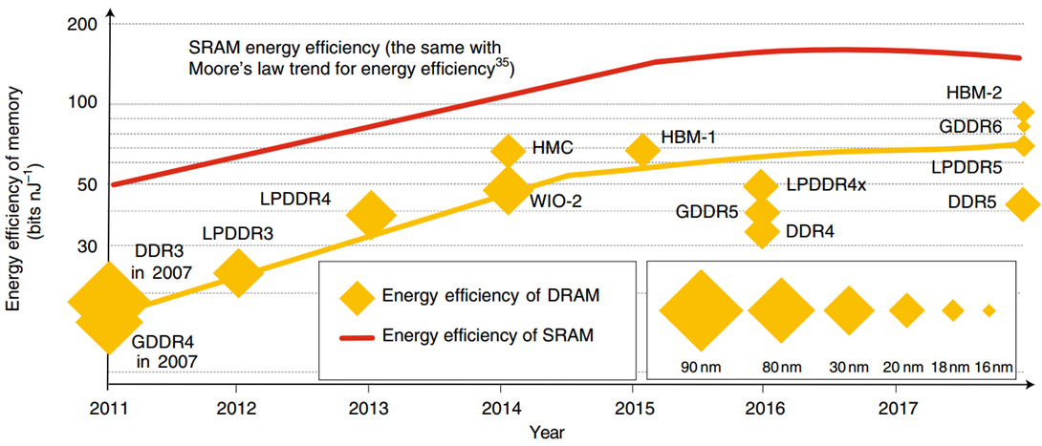
Challenges of ML on Edge Storage energy efficiency gap
Number of DNN parameters increases exponentially
Energy efficiency of memory almost stops increasing
Xu, Xiaowei, et al. "Scaling for edge inference of deep neural networks." Nature Electronics 1.4 (2018): 216.

Slide 22
Course Overview

Slide 23
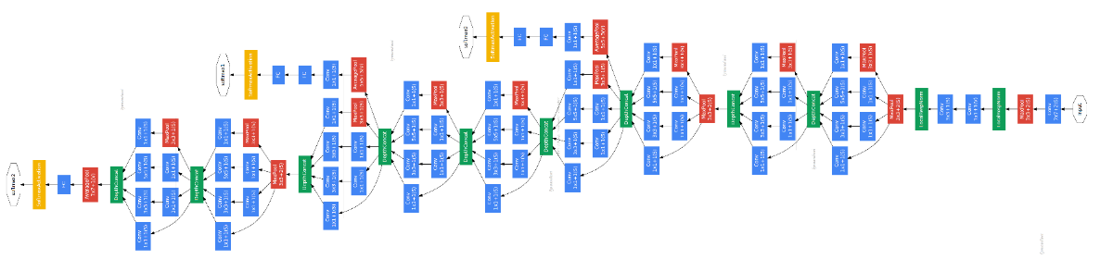
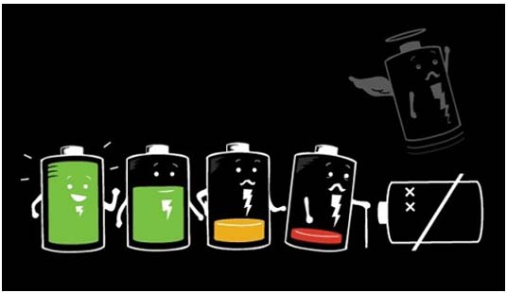
What is This Course About? Open question on Machine Learning for Embedded Systems!
Machine Learning
High computation complexity
High storage complexity
Embedded Systems
Low power
Small on-chip memory
Low bandwidth
Real-time requirements
V.S.
How to overcome the limitations of embedded systems?

Slide 24
What is This Course About? Software side: AI/ML/DL?
Artificial Intelligence (AI)
[Definition] AI is intelligence demonstrated by machines, unlike the natural intelligence displayed by humans and animals, which involves consciousness and emotionality.

Slide 25
What is This Course About? Software side: AI/ML/DL?
Artificial Intelligence (AI)
Machine Learning (ML)
[Definition] ML is the study of computer algorithms that improve automatically through experience and by the use of data. It is seen as a part of AI.
ECE 527: Learning From Data

Slide 26
What is This Course About? Software side: AI/ML/DL?
Artificial Intelligence (AI)
Machine Learning (ML)
Deep Learning (DL)
[Definition] DL is a class of ML Algorithms that uses multiple layers to progressively extract higher-level features from the raw input.
Computer Vision
Natural Language
Games
…

Slide 27

What is This Course About? Overview: software side
Application
ML/DL Algorithms
Optimization
Computer Vision
AN
MLP
CNN
Network Inference
Software
Natural Language
Network Training
RNN
LSTM
RL
Games
Transformer
MLP-Mixer
…
…
High Accuracy

Slide 28
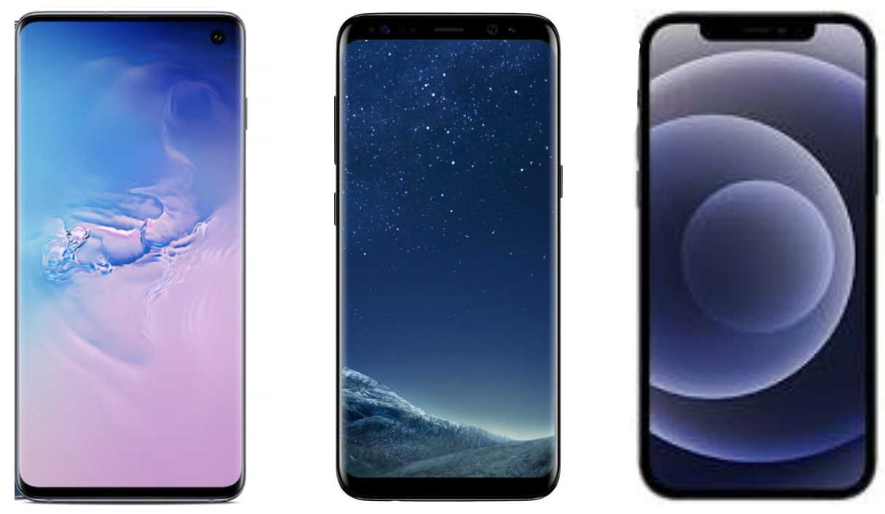
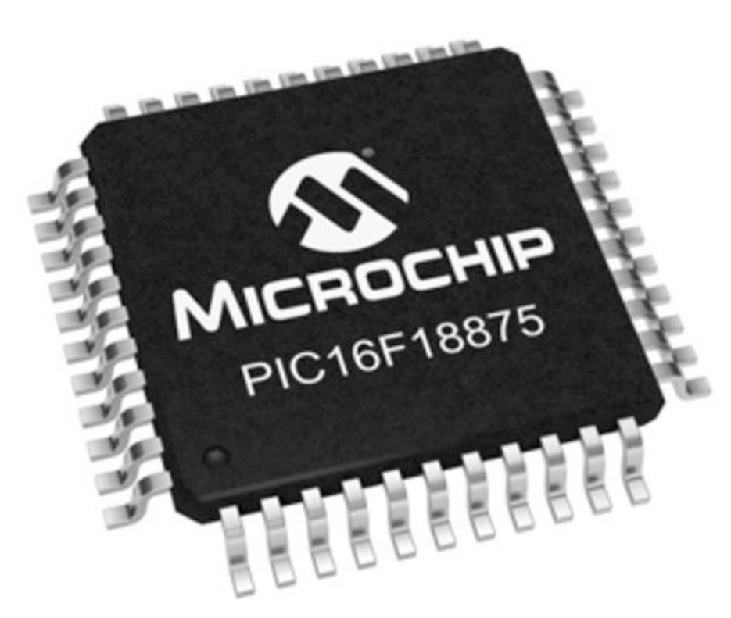
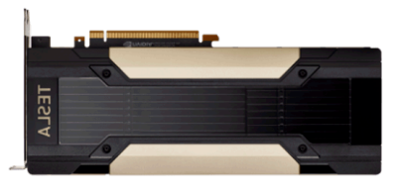
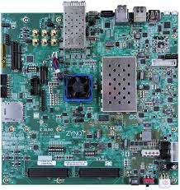
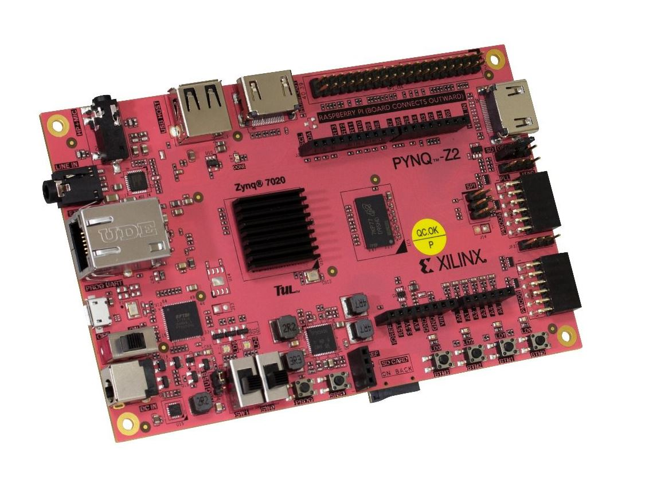
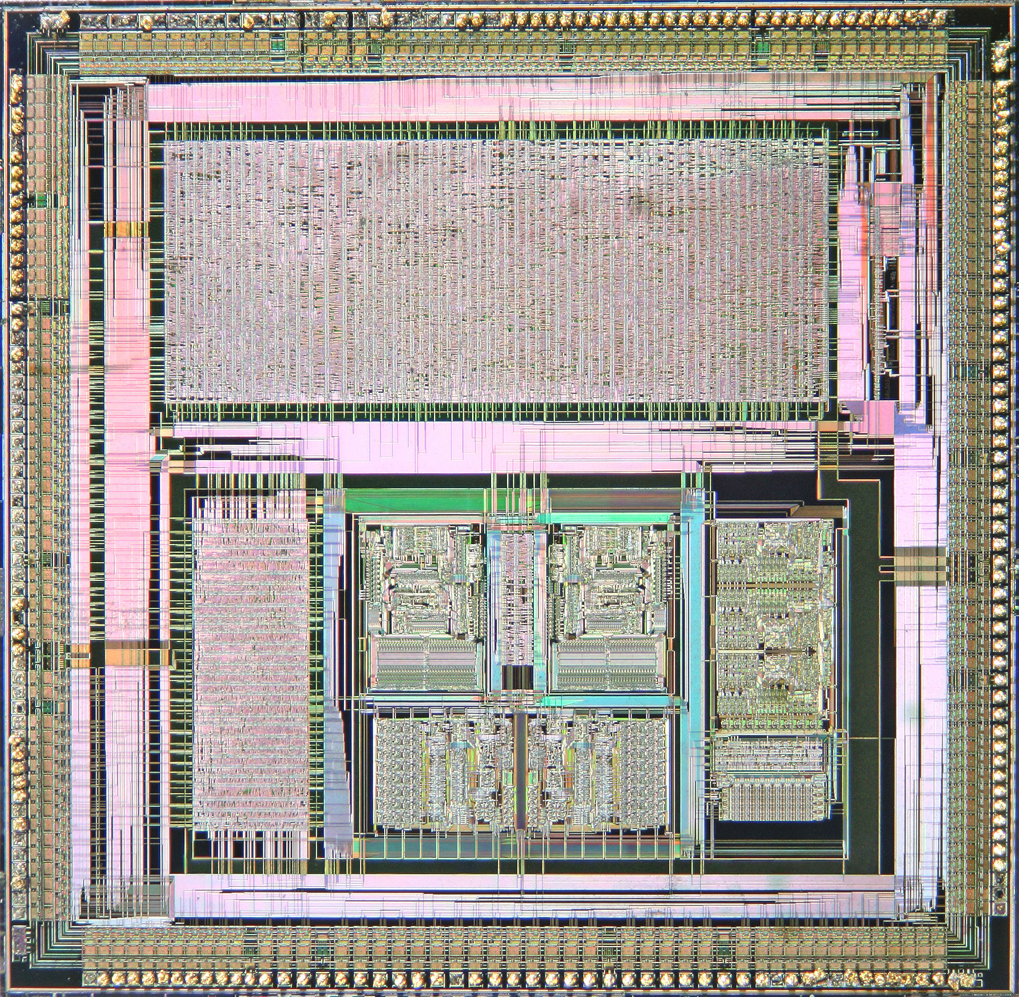
What is This Course About? Hardware side: from cloud to edge
ECE 350: Embedded Systems and Hardware Interfaces
Mobile Device
Microcontroller
Cloud GPU/CPU
General Purpose Computing
Customized Computing
ECE 231: Digital System Design
FPGA
Field-Programmable Gate Array
ASIC
Application Specifical Integrate Circuit

Slide 29
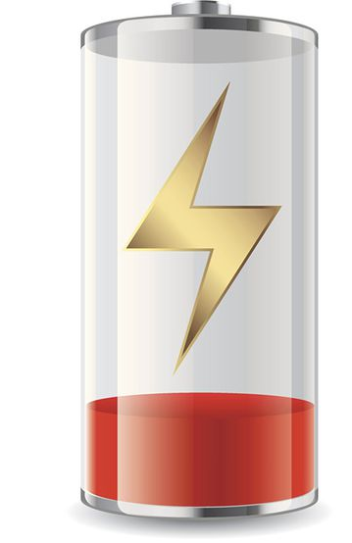

What is This Course About? Overview
Application
ML/DL Algorithms
Optimization
Computer Vision
AN
MLP
CNN
Network Inference
Software
Natural Language
Network Training
RNN
LSTM
RL
Games
Model Compression
Transformer
MLP-Mixer
…
…
Network Design
Embedded Systems
ECE 699: Hardware Accelerators for Machine Learning
Hardware
Low-Power
Low-Latency

Slide 30
What is This Course About? Overview
Application
ML/DL Algorithms
Optimization
Computer Vision
AN
MLP
CNN
Network Inference
Software
Natural Language
Network Training
RNN
LSTM
RL
Games
Model Compression
Transformer
MLP-Mixer
…
…
Network Design
Embedded Systems
Performance Model
Optimization
Resource Usage
Hardware Design
Hardware
Power
Mapping/Scheduling
Latency
Communication

Slide 31
Week 1: Introduction to Artificial Neuron and MLP
Application
ML/DL Algorithms
Optimization
Computer Vision
AN
MLP
CNN
Network Inference
Software
Natural Language
Network Training
RNN
LSTM
RL
Games
Model Compression
Transformer
MLP-Mixer
…
…
Network Design
Embedded Systems
Performance Model
Optimization
Resource Usage
Hardware Design
Hardware
Power
Mapping/Scheduling
Latency
Communication

Slide 32
Week 2: From Inference to Training, From MLP to CNN
Application
ML/DL Algorithms
Optimization
Computer Vision
AN
MLP
CNN
Network Inference
Software
Natural Language
Network Training
RNN
LSTM
RL
Games
Model Compression
Transformer
MLP-Mixer
…
…
Network Design
Embedded Systems
Performance Model
Optimization
Resource Usage
Hardware Design
Hardware
Power
Mapping/Scheduling
Latency
Communication

Slide 33
Week 3-4: From CV to NLP
Application
ML/DL Algorithms
Optimization
Computer Vision
AN
MLP
CNN
Network Inference
Software
Natural Language
Network Training
RNN
LSTM
RL
Games
Model Compression
Transformer
MLP-Mixer
…
…
Network Design
Embedded Systems
Performance Model
Optimization
Resource Usage
Hardware Design
Hardware
Power
Mapping/Scheduling
Latency
Communication

Slide 34
Week 5-6: Model Compression
Application
ML/DL Algorithms
Optimization
Computer Vision
AN
MLP
CNN
Network Inference
Software
Natural Language
Network Training
RNN
LSTM
RL
Games
Model Compression
Transformer
MLP-Mixer
…
…
Network Design
Embedded Systems
Performance Model
Optimization
Resource Usage
Hardware Design
Hardware
Power
Mapping/Scheduling
Latency
Communication

Slide 35
Week 7: From Deep Learning to Deep Reinforcement Learning
Application
ML/DL Algorithms
Optimization
Computer Vision
AN
MLP
CNN
Network Inference
Software
Natural Language
Network Training
RNN
LSTM
RL
Games
Model Compression
Transformer
MLP-Mixer
…
…
Network Design
Embedded Systems
Performance Model
Optimization
Resource Usage
Hardware Design
Hardware
Power
Mapping/Scheduling
Latency
Communication

Slide 36
Week 8: RL-based Network Design (Neural Architecture Search)
Application
ML/DL Algorithms
Optimization
Computer Vision
AN
MLP
CNN
Network Inference
Software
Natural Language
Network Training
RNN
LSTM
RL
Games
Model Compression
Transformer
MLP-Mixer
…
…
Network Design
Embedded Systems
Performance Model
Optimization
Resource Usage
Hardware Design
Hardware
Power
Mapping/Scheduling
Latency
Communication

Slide 37
Week 9: Hardware-Aware Neural Architecture Search
Application
ML/DL Algorithms
Optimization
Computer Vision
AN
MLP
CNN
Network Inference
Software
Natural Language
Network Training
RNN
LSTM
RL
Games
Model Compression
Transformer
MLP-Mixer
…
…
Network Design
Embedded Systems
Performance Model
Optimization
Resource Usage
Hardware Design
Hardware
Power
Mapping/Scheduling
Latency
Communication

Slide 38
Week 10-11: ML Accelerator Design
Application
ML/DL Algorithms
Optimization
Computer Vision
AN
MLP
CNN
Network Inference
Software
Natural Language
Network Training
RNN
LSTM
RL
Games
Model Compression
Transformer
MLP-Mixer
…
…
Network Design
Embedded Systems
Performance Model
Optimization
Resource Usage
Hardware Design
Hardware
Power
Mapping/Scheduling
Latency
Communication

Slide 39
Week 12-14: HW/SW Co-Design with Neural Architecture Search
Application
ML/DL Algorithms
Optimization
Computer Vision
AN
MLP
CNN
Network Inference
Software
Natural Language
Network Training
RNN
LSTM
RL
Games
Model Compression
Transformer
MLP-Mixer
…
…
Network Design
Embedded Systems
Performance Model
Optimization
Resource Usage
Hardware Design
Hardware
Power
Mapping/Scheduling
Latency
Communication

Slide 40
Introduction to Artificial Neuron and MLP

Slide 41
Week 1: Introduction to Neural Network
Application
ML/DL Algorithms
Optimization
Computer Vision
AN
MLP
CNN
Network Inference
Software
Natural Language
Network Training
RNN
LSTM
RL
Games
Model Compression
Transformer
MLP-Mixer
…
…
Network Design
Embedded Systems
Performance Model
Optimization
Resource Usage
Hardware Design
Hardware
Power
Mapping/Scheduling
Latency
Communication

Slide 42
Why Neural Networks
An emulation of the biological neural systems
Parallel computation
Adaptive connections
Very different style from sequential computation
Should be good for things that brains are good at (e.g., vision)
Should be bad for things that brains are bad at (e.g., 23 x 71)
To solve practical problems by using novel learning algorithms inspired by the brain
Learning algorithms can be very useful even if they are not how the brain actually works.

Slide 43
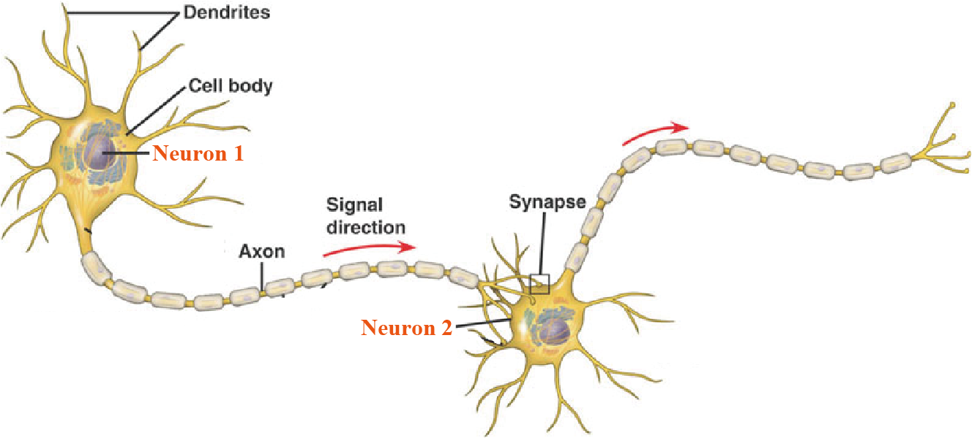
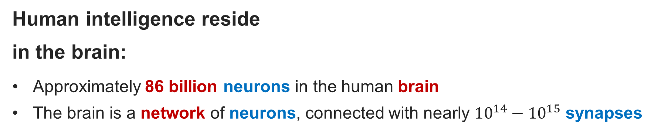
Biological Neuron
Human intelligence reside
in the brain:
Approximately 86 billion neurons in the human brain
The brain is a network of neurons, connected with nearly $10^{14}−10^{15}$ synapses
How to equip intelligence in the machine?
To understand how the brain network is constructed
To mimic the brain

Slide 44
Biological Neuron
Neurons work together:
Cell body process the information
Dendrites receive messages from other neurons
Axon transmit the output to many smaller branches
Synapses are the contact points between axon (Neuron 1) and dendrites (Neuron 2) for message passing
Cell body receives input signal from dendrites and produce output signal along axon, which interact with the next neurons via synaptic weights
Synaptic weights are learnable to perform useful computations
(e.g., Recognizing objects, understanding language, making plans, controlling the body.)

Slide 45
Artificial Neuron Design
Idealized neuron models
Idealization removes complicated details that are not essential for understanding the main principles.
It allows us to apply mathematics and to make analogies.
Notes:
http://www.cse.iitm.ac.in/~miteshk/CS7015/Slides/Teaching/pdf/Lecture2.pdf
https://web.csulb.edu/~cwallis/artificialn/History.htm

Slide 46
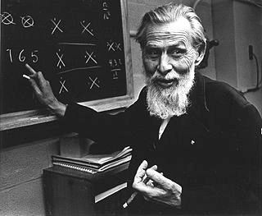
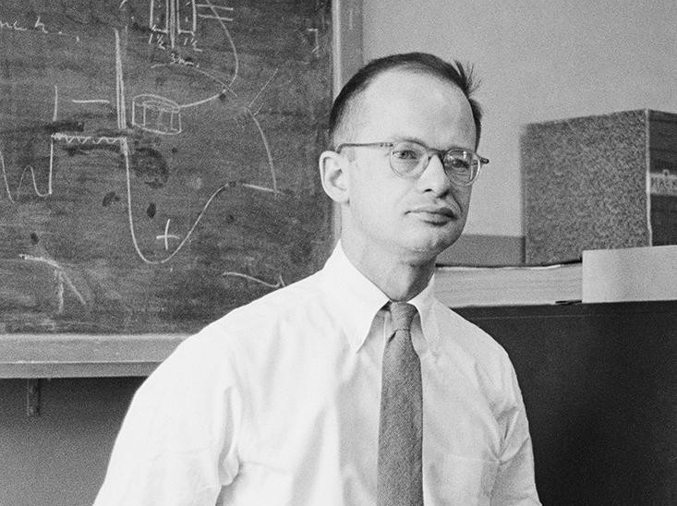

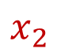


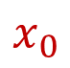
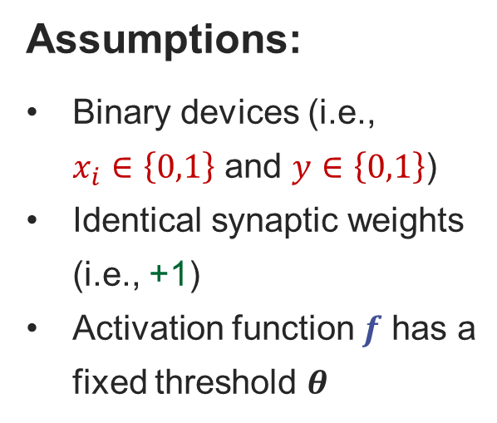

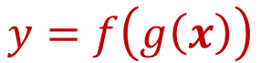
McCulloch-Pitts Neuron The first computational model of a biological neuron @ 1943
Synapse
Signal Direction
Assumptions:
Binary devices (i.e., $x_{i}∈\left\{0,1\right\}$ and $y∈\left\{0,1\right\}$)
Identical synaptic weights (i.e., +1)
Activation function $f$ has a fixed threshold $θ$
$$x_{0}$$
Dendrite
+1
Cell Body
Synapse
Axon
$$x_{1}$$
$$g$$
$$f$$
Warren McCulloch
Dendrite
$$y=f\left(g\left(x\right)\right)$$
+1
Synapse
Dendrite
y
$$x_{2}$$
1
+1
Walter Pitts
0
$$θ$$

Slide 47
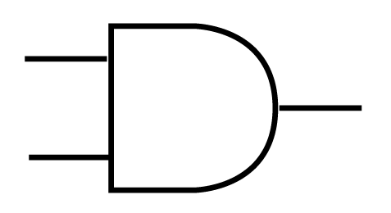



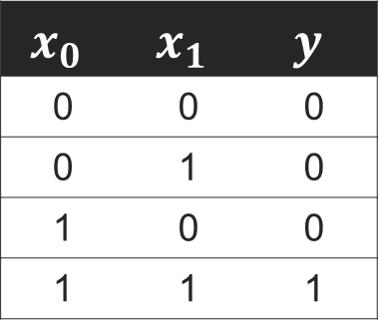

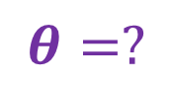




McCulloch-Pitts Neuron Boolean function ‘AND’ can be implemented by using MP Neuron
$$x_{0}$$
$$x_{0}$$
$$y$$
$$f$$
$$y$$
$$g$$
$$x_{1}$$
$$θ=?$$
$$x_{1}$$
AND Gate
$$x_{0}$$ | $$x_{1}$$ | $$y$$
0 | 0 | 0
0 | 1 | 0
1 | 0 | 0
1 | 1 | 1

Slide 48
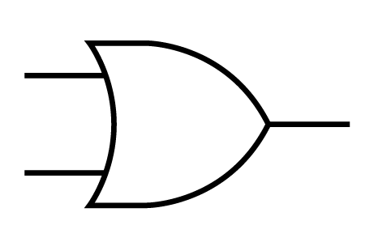

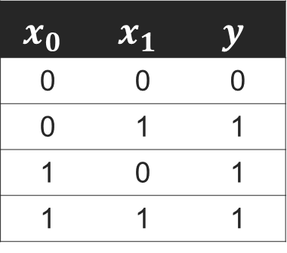

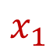
McCulloch-Pitts Neuron Boolean function ‘OR’ can be implemented by using MP Neuron
$$x_{0}$$
$$x_{0}$$
$$y$$
$$f$$
$$y$$
$$g$$
$$x_{1}$$
$$θ=?$$
$$x_{1}$$
OR Gate
$$x_{0}$$ | $$x_{1}$$ | $$y$$
0 | 0 | 0
0 | 1 | 1
1 | 0 | 1
1 | 1 | 1

Slide 49

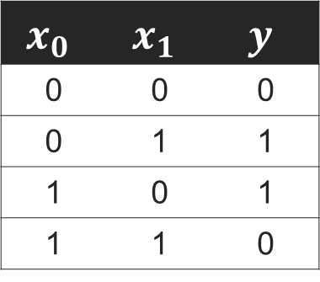



McCulloch-Pitts Neuron Boolean function XOR cannot be implemented by using MP Neuron
$$x_{0}$$
$$x_{0}$$
$$y$$
$$y$$
$$g$$
$$f$$
$$x_{1}$$
$$θ=?$$
$$x_{1}$$
XOR Gate
$$x_{0}$$ | $$x_{1}$$ | $$y$$
0 | 0 | 0
0 | 1 | 1
1 | 0 | 1
1 | 1 | 0
MP Neuron is limited to only solve linearly separable functions!

Slide 50
Artificial Neuron Design
Idealized neuron models
Idealization removes complicated details that are not essential for understanding the main principles.
It allows us to apply mathematics and to make analogies.
Break the limitations on MP Neuron
What about non-boolean inputs (say, real number)?
What if we want to assign more weight (importance) to some inputs?
Do we always need to hand code the threshold?
What about activation functions other than threshold step function?
What about functions which are not linearly separable ?

Slide 51



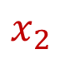
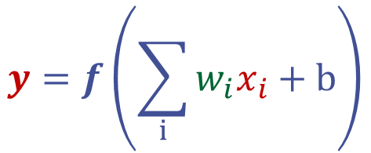

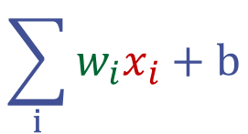
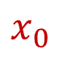
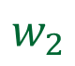
Perceptron Frank Rosenblatt @ 1958
Synapse
$$x_{0}$$
Dendrite
Cell Body
$$w_{0}$$
$$y=f\left(\sum_{i}{w_{i}x_{i}}+b\right)$$
Synapse
$$x_{1}$$
$$\sum_{i}{w_{i}x_{i}}+b$$
$$f$$
$$w_{1}$$
Dendrite
Axon
Synapse
$$x_{2}$$
Dendrite
$$w_{2}$$
Message Travel Direction

Slide 52
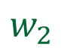
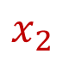
















Perceptron What is Bias b?
$$x_{0}$$
$$w_{0}$$
Cell Body
$$x_{0}$$
$$w_{0}$$
Cell Body
$$x_{1}$$
$$w_{1}$$
$$\sum_{i}{w_{i}x_{i}}$$
$$w_{1}$$
$$\sum_{i}{w_{i}x_{i}}+b$$
$$f$$
$$x_{1}$$
$$f$$
$$w_{2}$$
$$w_{2}$$
$$x_{2}$$
$$x_{2}$$
$$w_{3}=+1$$
$$b$$

Slide 53










Perceptron Effect of bias b on Threshold Step activation function.
$$f$$
$$f$$
$$x_{0}$$
$$w_{0}$$
Cell Body
1
1
0
$$θ$$
0
$$x_{1}$$
$$w_{1}$$
$$\sum_{i}{w_{i}x_{i}}+b$$
$$f$$
$$b=0$$
$$b=−θ$$
$$w_{2}$$
$$z=\sum_{i}{x_{i}w_{i}}$$
$$z=\sum_{i}{x_{i}w_{i}}−θ$$
$$x_{2}$$
$$y=\left\{\begin{aligned}\begin{matrix}1 & if z>θ \end{matrix} \\ \begin{matrix}0 & otherwise\end{matrix}\end{aligned}\right.$$
$$y=\left\{\begin{aligned}\begin{matrix}1 & if z>0 \end{matrix} \\ \begin{matrix}0 & otherwise\end{matrix}\end{aligned}\right.$$

Slide 54


Perceptron v.s. MP Neuron
Perceptron
MP Neuron
$$y=\left\{\begin{aligned}\begin{matrix}1 & if\sum_{i}{x_{i}w_{i}}+b>0\end{matrix} \\ \begin{matrix}0 & otherwise\end{matrix}\end{aligned}\right.$$
$$y=\left\{\begin{aligned}\begin{matrix}1 & if\sum_{i}{x_{i}}>θ\end{matrix} \\ \begin{matrix}0 & otherwise\end{matrix}\end{aligned}\right.$$
In Perceptron: the inputs can be real numbers; the weights (including threshold) can be learned/trained.
In Perceptron: like MP Neuron, the Perceptron separates the input space into two halves. However, all inputs producing 1 lie on one side, and those producing 0 lie on the other side.
===> A single perceptron can still only used to implement linearly separable functions, but not for XOR-like function.

Slide 55
Artificial Neuron Design
Idealized neuron models
Idealization removes complicated details that are not essential for understanding the main principles.
It allows us to apply mathematics and to make analogies.
Break the limitations on MP Neuron
What about non-boolean inputs (say, real number)? ✔
What if we want to assign more weight (importance) to some inputs? ✔
What about functions which are not linearly separable ? ❓ => MLP
Do we always need to hand code the threshold? ❓ => Training

Slide 56









Multi-Layer Perceptron (MLP) Connect two neurons
$$x_{0}$$
Neuron 1
Neuron 2
$$v_{0}$$
$$z_{0}$$
$$w_{0}$$
$$y_{0}$$
$$v_{1}$$
$$x_{1}$$
$$y_{1}$$
Signal Direction
$$w_{1}$$

Slide 57
Multi-Layer Perceptron (MLP) Connect more neurons and more layers
b=0
b=0
Output Layer (Layer 3)
-1
-1
1
1
1
1
b=0.5
b=1
b=2
Hidden Layer (Layer 2)
1
5
2
2
5
1
1
0
-1
0
Input Layer (Layer 1)

Slide 58
Lab 1: Implementing XOR using MLP on Google Colab
Assignments and Related Documents:
https://jqub.github.io/2021/09/01/ML4Emb/
Due Date: This Friday by 1 PM
Please take this chance to evaluate the required programming background and the required bandwidth to decide whether keep or drop this course.

Slide 59
GMU.EDU
George Mason University
4400 University Drive Fairfax, Virginia 22030
Tel: (703)993-1000

Slide 60











Artificial Neurons
Two Neurons:
$$x_{0}$$
Neuron 1
$$w_{0}$$
Neuron 2
$$v_{0}$$
$$z_{0}$$
$$y_{0}$$
$$x_{1}$$
$$w_{1}$$
$$v_{1}$$
$$y_{1}$$
$$x_{2}$$
$$w_{2}$$
Message Travel Direction

Slide 61

What You are Expected to Learn! What’s Next?
Classical Computing
Quantum Computing

Slide 62
What You are Expected to Learn! What’s Next?
Application
ML/DL Algorithms
Optimization
Computer Vision
AN
MLP
CNN
Network Design
Software
Natural Language
GNN
RNN
LSTM
Network Training
Games
Transformer
MLP-Mixer
…
…
Model Compression
Embedded Systems
Advanced Computing
ECE 699: Advanced Machine Learning Systems (Spring 2022)
Instructor: Dr. Weiwen Jiang
Hardware

